Slide 1


CELCIUS STUDIOS
1.16.2024
Elevating Your Online Presence
Celcius Studios

Slide 2

Agenda
1 | About the Company
2 | Our Mission and Vision
3 | Our Offered Services
4 | Pricing Plans
5 | Our Goals
6 | Our Market
7 | Our Milestones
8 | How it works
9 | Our Management Team
10 | Contact Information

Slide 3

About the Company
At Celcius Studios, we blend creativity with technology to redefine your digital presence. Established with a passion for excellence, we are your trusted partner in the realms of content writing and SEO services.
Back to Agenda

Slide 4

Our Mission and Vision
Mission
Vision
Empower businesses through impactful content and strategic SEO. Commitment to excellence, transparency, and innovation drives lasting partnerships for measurable success.
To be a leading force in shaping the future of digital presence. Set industry standards through innovation, client-centric approaches, and excellence, becoming the go-to partner for online success.
Back to Agenda

Slide 5
Our Offered Services
Content Writing Services
SEO Services
Analytics and Reporting
Digital Marketing Consultation
Website Optimization
Social Media Management
Back to Agenda

Slide 6
Service Package | Features Included | Pricing (Per Month)
Basic Content Boost | 4 blog posts (500 words each) Basic SEO optimization Monthly performance report | $500
Pro Content Package | 8 blog posts (700 words each) Advanced SEO strategies Social media integration Bi-weekly consultation sessions | $1,000
Business Growth SEO & Content Overhaul | Comprehensive content strategy 12 blog posts (1000 words each) In-depth SEO analysis and implementation Monthly analytics and strategy refinement Social media management | $2,500
Custom Enterprise | Tailored content solutions Unlimited blog posts, articles, and web content Advanced SEO and competitor analysis Dedicated account manager | Custom Quote
Pricing Plans

Slide 7



Our Goals
Drive Impactful Results
Innovate Continuously
Forge Lasting Partnership
Deliver measurable impact for our clients through compelling content and effective SEO strategies.
Pioneer innovation in the digital landscape, staying ahead of industry trends and utilizing cutting-edge tools
Build enduring relationships with clients, founded on transparency, collaboration, and a commitment to their long-term success
Back to Agenda

Slide 8
Our Market
52.95 Billion
13.24 Billion
Total Available Market (TAM):
52.95 Billion
1.32 Billion
Serviceable Available Market (SAM):
13.24 Billion
Serviceable Obtainable Market (SOM):
1.32 Billion
Back to Agenda

Slide 9
Our Milestones
2024
2025
2026
2027
Successfully launch the company and acquire the first set of clients, establishing a foundation for growth.
Expand services to new geographic regions, tapping into diverse markets and growing the client base.
Establish the company as a thought leader in the industry, implementing a comprehensive branding and marketing campaign.
Create an innovation hub within the company and develop a detailed plan for scaling operations.
Back to Agenda

Slide 10

How It Works.
Client Onboarding:
Description: Begin your journey with a seamless onboarding process.
Process Highlights:
Initial Consultation: Understand your goals, requirements, and expectations.
Needs Assessment: Identify specific content and SEO needs for a tailored approach.
Agreement and Kickoff: Finalize terms, ensuring a smooth transition to project initiation.
Back to Agenda

Slide 11
How It Works.
Project Delivery:
Description: Experience timely and high-quality delivery of your content and SEO projects.
Process Highlights:
Strategy Development: Craft a personalized strategy aligned with your objectives.
Content Creation: Execute the plan with a focus on creativity and engagement.
SEO Optimization: Implement cutting-edge SEO techniques for enhanced visibility.
Quality Assurance: Rigorous checks to ensure the highest standards before delivery.
Back to Agenda

Slide 12
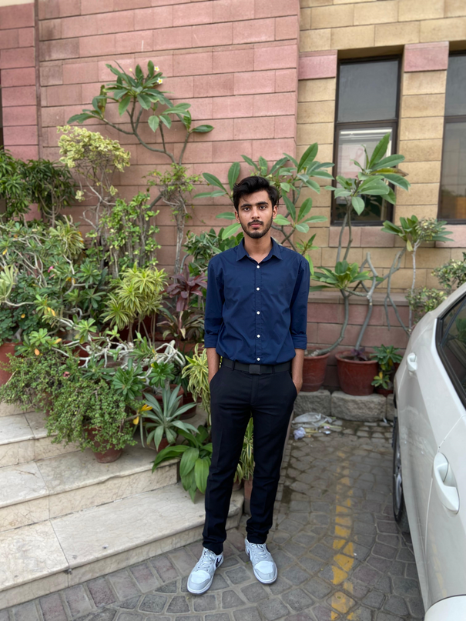
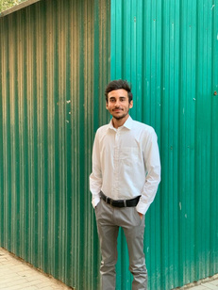
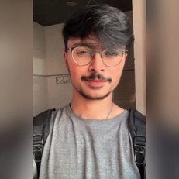
Our Management Team
Kazim Raza Rizvi
Chief Executive Officer
Sayed Abdullah
Chief Technology Officer
Tayyab Syed
Director
Back to Agenda

Slide 13

CELCIUS STUDIOS
Connect with us.
Email
celciusstudios56@gmail.com
Social Media
@studiocelciusco
Call us
+93 (33) 2512070

